Slide 1

Restaurant Management System OBJECT ORIENTED PROGRAMING JAVA LANGUAGE
Submitted BY:
Group No:5
G. Sushanth(2203A51L13)
Under the guidance of:
P. SRAVAN

Slide 2
Contents:
Abstract
Objective
Elements used in the Project
Sign-in page
Login page
Sign-up page
Home page
Menu
About us
Reviews
Contact-us
Restaurant Login page
Restaurant Management page

Slide 3
Abstract:
The restaurant industry is a dynamic and highly competitive field, requiring efficient management systems to meet customer demands and stay ahead of the competition. This abstract presents a Restaurant Management System (RMS) designed to display menus that can be easily added, displayed, and updated in a user-friendly manner. This system offers restaurateurs a comprehensive solution to streamline menu management and enhance customer experiences.
In summary, the Restaurant Management System outlined in this abstract addresses the needs of modern restaurant management by offering a platform that simplifies the process of adding, displaying, and updating menus. The system improves customer engagement, streamlines operations, and helps restaurants adapt quickly to changing market demands, making it an invaluable tool for restaurant owners and managers seeking to thrive in a competitive industry.

Slide 4
Objective
This project focuses on the Restaurant Management System Where the Admin can manage to change the Menu on the customer side which also means the admin can add, update and delete the dishes that are available on that specific day so that would be easy to customer to choose the available dishes and would avoid the time waste for the waiter to describe the dish whether it is available or not and this has lot of scope in upcoming days like we can add register table order from the table without no middle man contact. So, our project basically is made for displaying the available restaurant menu on the restaurant working day.

Slide 5
Elements Used In Project
JFrame: The main window of the application.
JPanel (contentPane): The main container for organizing components.
JLabel: Display text or image. Used for the application title.
JTable: provides a tabular view for displaying data.
JButton: A button that performs actions, such as navigation to different sections.
ActionListener: Interface to handle button click events.
ImageIcon: Represents an image, used for buttons with icons.
Dispose(): Closes the current window.
setVisible(): Sets the visibility of the window.
EventQueue.invokeLater(): Ensures that UI updates are done on the event dispatching thread.
JTextField, JPasswordField: For user input (username and password).
JOptionPane: Displays dialog boxes, used for showing error messages.
JScrollPane: Allows scrolling through reviews.
ImageIcon: Represents user icons and rating icons.
JDBC (Java Database Connectivity): Establishes a connection to a MySQL database.

Slide 6
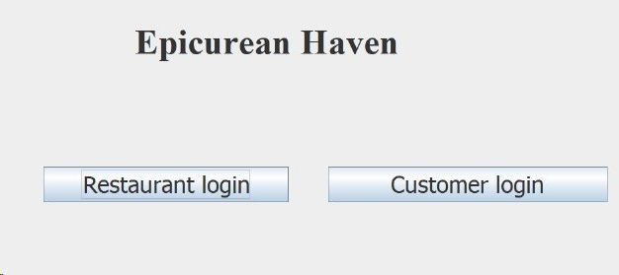
Sign-in page
To access Restaurant login page and customer login.
Where, Restaurant login links up to restaurant related page.
Customer login links up to user related features.

Slide 7
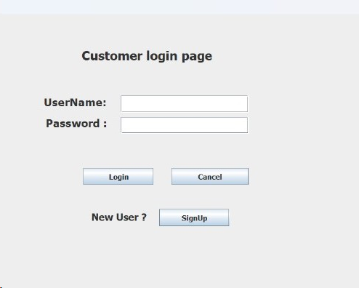
Sign-in page
A customer login page in a restaurant management system it gives
Basic security for customer seeing there menus and other details
If the login details is correct it redirects to home page else displays invalid username/password
If new user there is a sign-up button redirects to sign-up page

Slide 8
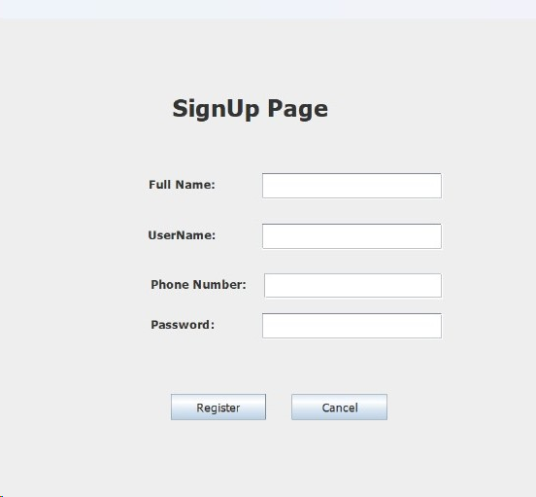
Sign-up page
The sign-up page for a restaurant management system
It enables new users to create accounts, providing essential information such as Full Name, User Name, Phone Number and password.
This registration process grants access to menu and browsing to see all the features
Here cancel button works to set all the text fields and password fields to set null

Slide 9
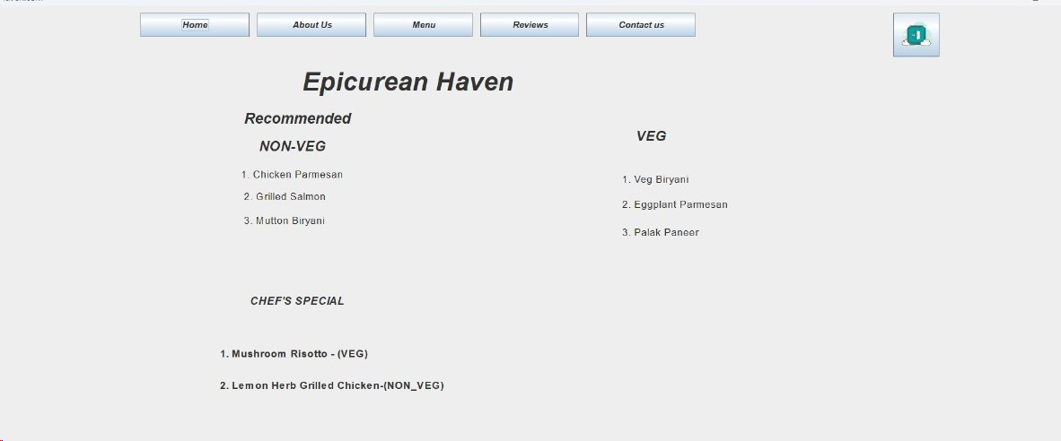
Home page
The home page of a restaurant management system
It serves as a centralized hub where users can access menus and can contact to make reservations, providing a seamless and convenient experience for both customers and staff.
And there can see special chef’s and types of items of different styles
If customer wants to log-out there is a
log-out button available

Slide 10
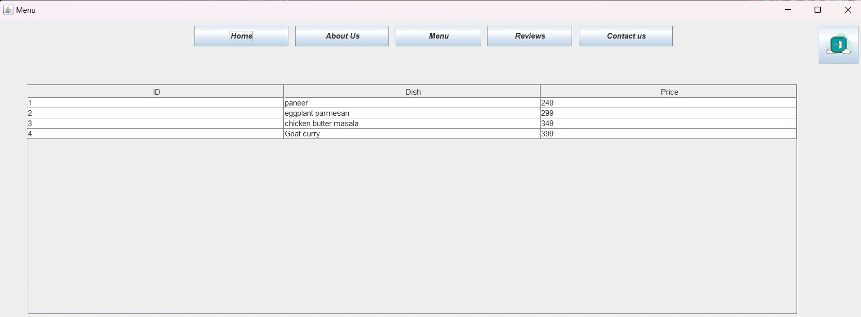
Menu
This is where the user can access the admin updated menu.
Here, it Displays the ID of dish, dish itself and the Price of the dish.
This page is a scrollable page so we can add as many as possible for the required menu.

Slide 11
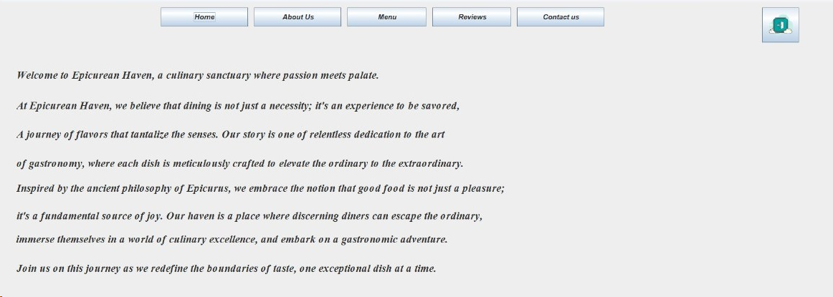
About us
It gives information about our restaurant management system epicurean haven
And gives briefly information about our services to the customers like how we cooperate with customers
It gives information about the chefs and dishes—ect
Also gives information about our journey and our story is one of relentless dedication of the heart

Slide 12
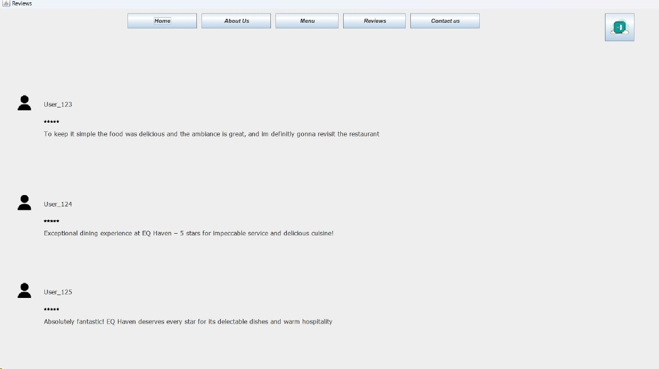
Reviews
The restaurant management system received positive reviews
for its user-friendly interface and efficient menu updates,
enhancing the overall dining experience.
These Restaurant have 5-star ratings and customers also satisfied with these
In these staff also will cooperate with us and there will support each and every one

Slide 13
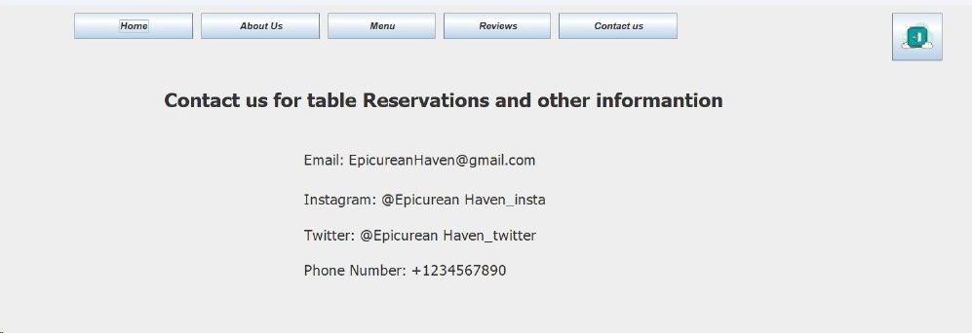
Contact-us
These Restaurant management System says about our information
It gives contact details for table reservations and other information or any queries
And it provides all the personal information about our restaurant like Email, Instagram, Twitter, phone number.
And here customer can also reserve a table with these page

Slide 14
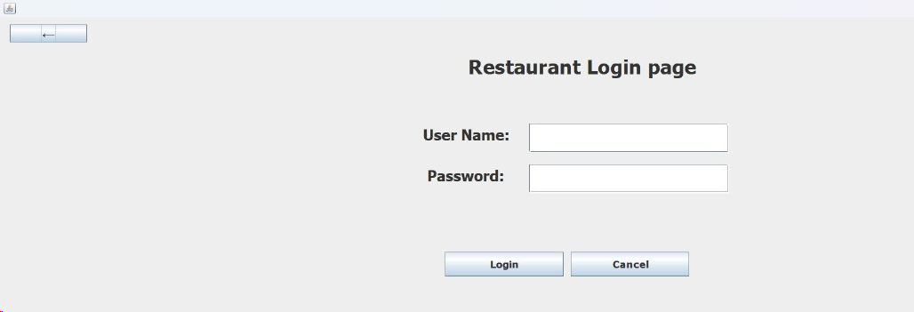
Restaurant Login page
The restaurant login page provides authorized staff access to the restaurant management system,
where they can manage reservations, update menus, and oversee daily operations efficiently.
Only staff can access these page no other people or customers cannot access these page

Slide 15
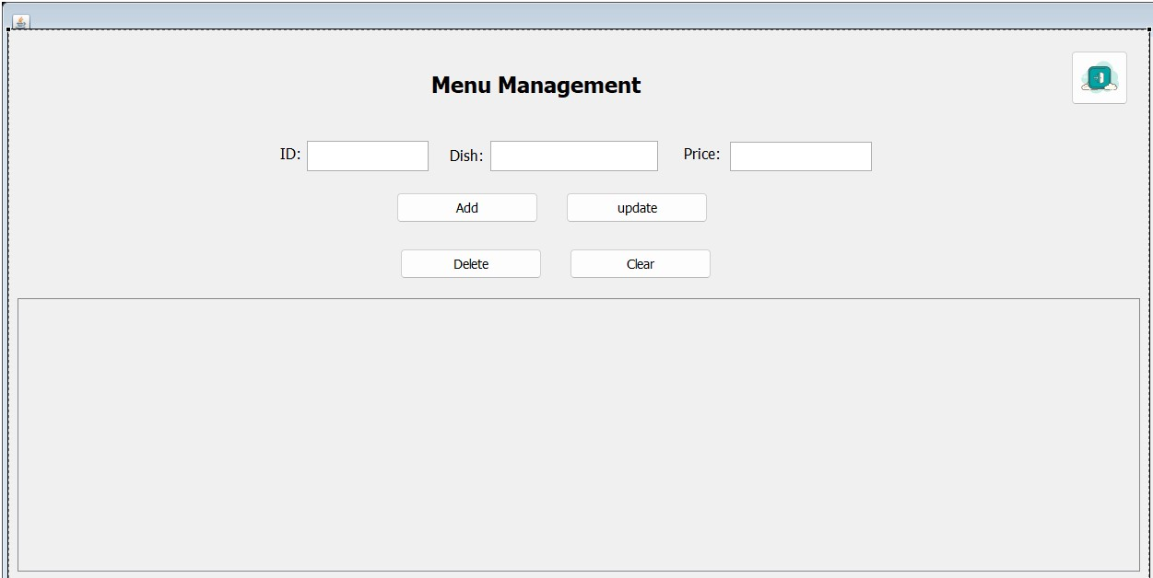
Restaurant Management page
Menu Management,
Where the admin can manage the menu can add, update, delete and clear.
It directly updates in the database and displays in user menu page.
If there is any existing we can also update the accordingly.
Also, we can delete the item if not available in the restaurant.

Slide 16
Conclusion
Restaurant Management System simplifies menu updates, enhances customer interactions, and streamlines operations. It is an essential tool for modern restaurants looking to stay competitive and deliver exceptional dining experiences.
It is the best way where we can access all the menus and reserve a table it is the modern features.

Slide 17


